Slide 1
Airline Delay Pattern Analysis — 2024
Business Recommendations & Findings Summary
YARRAMSETTI RAMA SRI SAHITHI
Dataset: 7.06M U.S. Domestic Flights, 2024

Slide 2
Project Overview
Objective:
Analyze 2024 U.S. domestic flight delay patterns to identify root causes and recommend actionable operational improvements.
Tools Used:
Python (Pandas, NumPy) | MySQL Workbench | Power BI + DAX
Scope:
7,061,582 flights analyzed | 42 columns (35 original + 7 engineered)
Source: Kaggle Flight Delay Dataset 2024 (CC0 License)
Link:kaggle.com/datasets/hrishitpatil/flight-data-2024

Slide 3
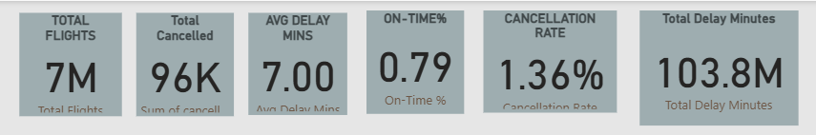
Key Performance Indicators
Total Flights: 7.06M
On-Time Rate: 78.78%
Avg Arrival Delay: 7.00 minutes
Cancellation Rate: 1.36%
Total Delay Minutes: 103.6M

Slide 4
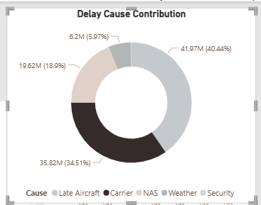
What's Driving the Delays?
Late Aircraft Delay: 41.97M minutes (40.4%)
Carrier Delay: 35.82M minutes (34.5%)
NAS Delay: 19.62M minutes (18.9%)
Weather Delay: 6.2M minutes (5.97%)
Security Delay: 0.18M minutes (0.17%)
Key Insight:
Operational causes (Late Aircraft + Carrier) account for ~75% of all delay minutes — far outweighing weather and security combined.

Slide 5
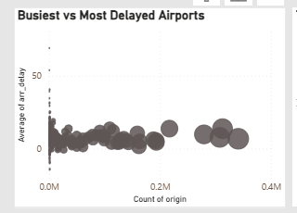
Performance Patterns
Best Performing Airline: YX (Republic Airways) — 84.82% on-time
Worst Performing Airline: F9 (Frontier) — 70.29% on-time
Worst Delay Day: Friday — 22.61% delay rate
Best Delay Day: Tuesday — 17.32% delay rate
Worst Delay Month: July — 28.87% delay rate
Calmest Months: September, October, November
Key Insight:
High airport traffic does not correlate with high delay — DFW ranks #2 in flight volume but only #48 in average delay.

Slide 6
Recommendations:
Prioritize turnaround-time and crew-scheduling improvements over weather mitigation investment. Late Aircraft + Carrier delays drive ~75% of delay minutes — far more than weather (5.97%) or security (0.17%).
Increase staffing and ground resources on Fridays and Sundays These two days consistently show the highest delay rates and average delay minutes across the year.
Conduct targeted root-cause reviews for chronically delayed regional routes and airports. Routes like RDM–DFW (86 min avg delay) and airports like HTS(42.79 min avg delay) show extreme, recurring delay patterns despite low flight volume — suggesting fixable local issues rather than random variance.
Initiate a cross-functional operational review for Frontier (F9). F9 ranks worst on both on-time performance (70.29%) and cancellation rate (2.32%) — a consistent pattern across two independent metrics signals a systemic reliability issue, not an isolated cause.
Maintain current infrastructure investment levels at major hubs;redirect incremental budget toward regional route reliability. Since high-traffic hubs (ATL, DFW, ORD) are not among the most delayed airports, current hub-level systems are performing adequately — regional/seasonal routes offer higher ROI for improvement spend.

Slide 7
Validation & Process Improvements
UAT Summary:
Findings were cross-validated between Python (Pandas) and SQL (MySQL) analysis layers — all key metrics (delay rate, cancellation rate, average delay) matched exactly across both methods, confirming data integrity and analysis accuracy. Results were also reviewed with a peer for clarity and business relevance before finalizing.
Process Improvement Suggestions:
Automate monthly delay reporting via scheduled Power BI dataset refresh, replacing manual report generation.
Establish a standing delay-cause monitoring threshold (e.g., alert if monthly delay rate exceeds 25%) for proactive intervention.

Slide 8
Conclusion
Flight delays in 2024 were predominantly operational and addressable — not primarily driven by uncontrollable factors like weather.Targeted scheduling, staffing, and route-level interventions offer meaningful potential to improve on-time performance.
Next Steps:
Build a predictive delay-risk model using historical patterns
Extend dashboard with real-time data refresh capability
Expand analysis to multi-year trends for seasonality validation
Thank You

